Slide 1
Analytics Databases

Slide 2
Analytics Databases Background
Businesses will often want to run large internal queries across their data, that do full table scans. However, doing such a thing can take a huge performance hit on their database that deals with client interaction. Hence, they will typically have a second database, for analytics processing, where data is copied some period of time after the fact.
This is done using an ETL (Extract, Transform, Load) process which is typically scheduled as a batch job (we will discuss these later).

Slide 3
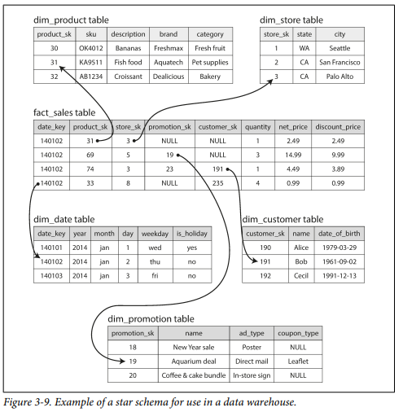
Stars and Snowflakes
In the transaction database, there may be many tables with all different types of relationships between them. However, in an analytics database, there is typically one central table known as the “fact” table. The fact table has many foreign keys which reference other tables known as dimension tables - this is called the “star” schema.
If the dimensions tables reference sub-dimensions tables, this is known as a snowflake schema.

Slide 4
Column Oriented Storage Background
Most transactions based databases use row oriented storage: they store the entire contents of a row together on disk to improve with locality.
However, in analytical queries, it is rare that we need the entire row, but rather are aggregating the value of one column over a certain table. Hence, it makes more sense to store the columns of the table together, known as column oriented storage.
Note that each column must be stored in the same order.

Slide 5
Compression
If each column has a lot of duplicate values, we can compress it to save space.
Imagine the following column representing coding proficiency out of 10:
8, 8, 8, 4, 5, 2, 2, 2, 2, 1

Slide 6
Compression
If each column has a lot of duplicate values, we can compress it to save space.
Imagine the following column representing coding proficiency out of 10:
8, 8, 8, 4, 5, 2, 2, 2, 2, 1
Bitmap encodings:
For val 8: 1 1 1 0 0 0 0 0 0 0
For val 4: 0 0 0 1 0 0 0 0 0 0
For val 5: 0 0 0 0 1 0 0 0 0 0
For val 2: 0 0 0 0 0 1 1 1 1 0
For val 1: 0 0 0 0 0 0 0 0 0 1

Slide 7
Compression
If each column has a lot of duplicate values, we can compress it to save space.
Imagine the following column representing coding proficiency out of 10:
8, 8, 8, 4, 5, 2, 2, 2, 2, 1
Bitmap encodings:
For val 8: 1 1 1 0 0 0 0 0 0 0
For val 4: 0 0 0 1 0 0 0 0 0 0
For val 5: 0 0 0 0 1 0 0 0 0 0
For val 2: 0 0 0 0 0 1 1 1 1 0
For val 1: 0 0 0 0 0 0 0 0 0 1
Run-Length encodings:
For val 8: 0, 3, 7
For val 4: 3, 1, 6
For val 5: 4, 1, 6
For val 2: 5, 4, 1
For val 1: 9, 1

Slide 8
Compression Continued
Perform bitwise operations on the encodings to find rows where multiple fields match certain values (column A = 10 AND column B = 20, could also do column A = 10 OR column A = 15)
Allows more data to fit in CPU cache
If you want columns sorted in a different way, can have a replica of the analytics database with a different sort order:
Acts as an index for efficient querying if you have a common query pattern
Allows more column compression

Slide 9
Writing to Column Oriented Storage
Inefficient writes because would have to modify every column file
Instead all writes go to a sorted tree in memory (LSM tree), which is eventually written in bulk to all of the column files once it gets too big
Reads must check both the tree and the column files and merge them

Slide 10
Materialized Views
Idea: Database precomputes common queries so they do not constantly have to be rerun
Pros:
Do not have to rerun certain expensive common aggregations
Cons:
Writes take longer since materialized views must be updated
Less flexibility than querying raw data

Slide 11
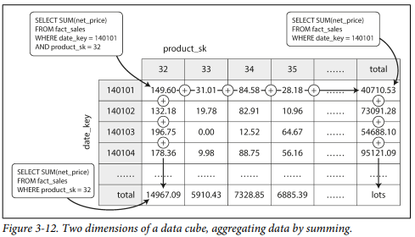
Data Cube
Idea: Special type of materialized view that precomputes a multi dimensional table (e.g. sales of every product_id on every day in the database)

Slide 12
Analytics Databases Summary
Very useful to decouple analytics databases from transactional ones as analytics queries can take a very long time.
Additionally, using an analytics database allows us to store our data in a column oriented manner, which once compressed, can be better utilized by a CPU’s cache and iterated on in tight loops (no function calls). When writing to column oriented storage, we can use an LSM tree as a buffer.
Finally, materialized views are a potentially very useful caching mechanism by analytics databases in order to avoid recomputation of popular aggregations, at the cost of slower writes.

